Slide 1

Recruiting for the BAC:
Template Flyer
November 2024
www.shvs.org

Slide 2
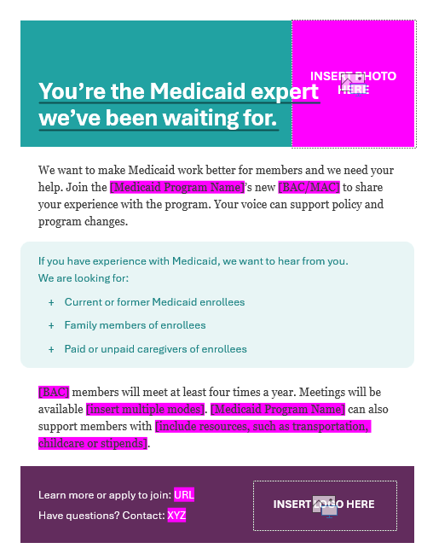
Tips to Create Your Own Recruitment Flyer
This slide deck contains template flyers to support state agencies in recruiting members for the Beneficiary Advisory Council (BAC). States can use the guidance below to customize the content of these flyers to their unique contexts and delete the two introductory slides as necessary. For additional customization support, please contact SHVS.
This document was created by State Health and Value Strategies. Support for this document was provided by the Robert Wood Johnson Foundation. The views expressed here do not necessarily reflect the views of the Foundation.
Use a simple headline and inclusive imagery.
Define the BAC
in terms that appeal to potential members. What’s in it for them?
Outline the types
of people you are seeking.
At a high-level, set expectations – for potential members and what the agency can offer.
Make the call to action simple. Include a state logo or seal to convey authority and trust.

Slide 3
You’re the Medicaid expert we’ve been waiting for.
We want to make Medicaid work better for members and we need your help. Join the [Medicaid Program Name]’s new [BAC/MAC]
to share your experience with the program. Your voice can support policy and program changes.
If you have experience with Medicaid, we want to hear from you.
We are looking for:
Current or former Medicaid enrollees
Family members of enrollees
Paid or unpaid caregivers of enrollees
[BAC] members will meet at least four times a year. Meetings will
be available [insert multiple modes]. [Medicaid Program Name]
can also support members with [include resources, such as transportation, childcare or stipends].
Learn more or apply to join: URL
Have questions? Contact: XYZ
Notes:
Template #1: Content-only
Customizable fields: Content and logo

Slide 4

You’re the Medicaid expert we’ve been waiting for.
We want to make Medicaid work better for members and we need your help. Join the [Medicaid Program Name]’s new [BAC/MAC] to share your experience with the program. Your voice can support policy and program changes.
If you have experience with Medicaid, we want to hear from you.
We are looking for:
Current or former Medicaid enrollees
Family members of enrollees
Paid or unpaid caregivers of enrollees
[BAC] members will meet at least four times a year. Meetings will be available [insert multiple modes]. [Medicaid Program Name] can also support members with [include resources, such as transportation, childcare or stipends].
Learn more or apply to join: URL
Have questions? Contact: XYZ
Notes:
Template #2: Content and image
Customizable fields: Content and logo

Slide 5
You’re the Medicaid expert we’ve been waiting for.
We want to make Medicaid work better for members and we need your help. Join the [Medicaid Program Name]’s new [BAC/MAC] to share your experience with the program. Your voice can support policy and program changes.
If you have experience with Medicaid, we want to hear from you.
We are looking for:
Current or former Medicaid enrollees
Family members of enrollees
Paid or unpaid caregivers of enrollees
[BAC] members will meet at least four times a year. Meetings will be available [insert multiple modes]. [Medicaid Program Name] can also support members with [include resources, such as transportation, childcare or stipends].
Learn more or apply to join: URL
Have questions? Contact: XYZ
Notes:
Template #3: Content and image
Customizable fields: Content, image, and logo

