Slide 1

State Strategies:
Medicaid Value-Based
Payment for LTSS
May 16, 2017

Slide 2

Webinar Presenter:
State Health and Value Strategies
Dan Meuse
Deputy Director
dmeuse@princeton.edu
2

Slide 3

The Robert Wood Johnson Foundation’s
State Health and Value Strategies Program
Supports state efforts to enhance the quality and value of health care by improving population health and reforming health care delivery.
Works directly with states—including Medicaid agencies, governors’ offices, and more—to promote peer-to-peer learning.
Connects states with technical assistance experts to develop tools for new quality improvement and cost management initiatives.
Collaborates with other funders and stakeholders to produce issue briefs and host convenings, focusing on best practices for states.
3

Slide 4


Webinar Presenters:
Gretchen Ulbee
Manager of Special
Needs Purchasing
MN DHS
Seon Rockwell
Director of Innovation
and Strategy
VA DMAS
4

Slide 5

Webinar Facilitator:
Erin Taylor
Bailit Health
etaylor@bailit-health.com
5

Slide 6
Logistics
This webinar is being recorded.
  The recording and slides will be available following the webinar.
Telephone lines will remain muted.
  We want everyone to be able to hear our presenters!
Questions can be submitted electronically at any time.
6
Notes:
Will the webinar be recorded?

Slide 7


Asking Questions Electronically
Right click on the Chat button in the top right of the WebEx program.
Type your question in the chat box. Select “All Panelists” and click “Send.”
The Q&A function can also be used in a similar way.
7

Slide 8
Overview
State attention to value-based payment for LTSS
State levers
State spotlight: Minnesota
State spotlight: Virginia
8

Slide 9
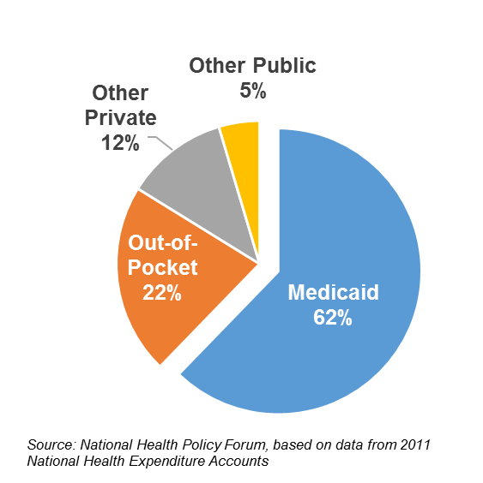
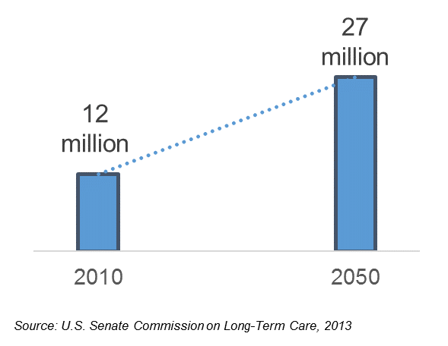
Overview
Americans needing long-term care will more than double by 2050
Medicaid is the primary payer of LTSS

Slide 10
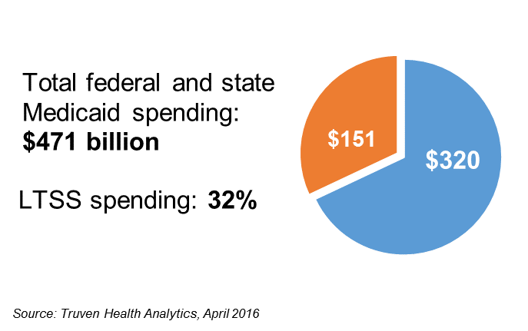
Overview
Total Medicaid Expenditures (2014)
Managed care spending on LTSS increased from 5% in 2009 to 15% in 2014, driven by an increase in state implementation of MLTSS programs

Slide 11
State Levers
Grants or capacity-building investments to support entry and readiness
Structure MLTSS contracts to direct or encourage value-based payment models (e.g., data and reporting requirements, payment targets)
Waiver terms and requests for DSRIP funds to support LTSS infrastructure development
Special Needs Plans contracting authority to further integrate and align financing and delivery

Slide 12
Medicaid Value-Based Payment for LTSS –Minnesota’s Approach
Gretchen Ulbee, Manager of Special Needs Purchasing
May 16, 2017

Slide 13
Minnesota Spotlight
Overview of Minnesota Senior Health Options (MSHO)
Minnesota DHS Value-Based Payment Strategy
Supports for Successful Value-Based Payment Models
Example ICSPs
Next Steps

Slide 14
Overview of MSHO
Minnesota Medicaid-eligible seniors are required to enroll in Medicaid managed care
Seniors may opt to receive Medicare with the same health plan providing their Medicaid coverage (MSHO)
  Integration of Medicare by MIPPA contract
  Requires coordination of benefits across programs
All Medicare and Medicaid primary and acute care services, dental, behavioral health, LTSS, HCBS waivers services, 180 days NF, Part D
  Seniors are in all settings and levels of care
Notes:
MSHO achieves integration of Medicare by MIPPA contract and requires coordination of benefits across programs. MSHO combines Medicare (including part D) and Medicaid services in one program.
Has been operating since 1997 under various authorities
Currently operating under the “Demonstration to Align Administrative Systems for Improvement in Beneficiary Experience” signed September 2013 – Not a Financial Alignment Demo

Slide 15
Making the Most of the Integration Opportunity
Decisions made by primary, acute and post-acute care providers paid under Medicare continue to drive State Medicaid and LTSS costs
  circular shifting between hospitals and NF
  primary care incentives to place difficult patients in NF
Opportunities to impact provider incentives and practice patterns are lost when FFS payment models are perpetuated within capitated programs

Slide 16
Value-Based Payment Objectives
Move away from FFS at provider levels
Align service delivery arrangements across settings
Create provider-level incentives
Use D-SNP platform to leverage Medicare involvement in payment reform

Slide 17
Integrated Care System Partnerships (ICSPs)
Multiple financial and delivery models tied to defined quality metrics are developed by D-SNPs
MCOs and provider partners develop arrangements and submit proposals to state
Must have four arrangements, one of which must include LTSS
State contract includes requirements to report on quality metrics and financial performance

Slide 18
Incorporating Quality Measurement
Convened a clinical work group of MCO Medical Directors and QA staff
Held discussions with state, local and national measurement experts (e.g., NCQA, Minnesota Community Measurement, Stratis Health)
Engaged providers and other stakeholders in measure development process
Notes:
Acknowledge that there are real and significant measurement challenges associated with these models and we know this will evolve with experience.

Slide 19
Incorporating Quality Measurement (cont’d)
Aimed to align measures as much as possible across health plans to minimize provider burden
Identified measure sets prior to implementation
Sample of selected measures
Advanced care planning | Fall with fracture | Inpatient admissions/readmissions | Physician Orders for Life Sustaining Treatment (POLST) documentation
Anti-depressant medication management | Fall risk management | Management of high risk medications | Pressure ulcers
Care of older adults | Flu shot | Medication reconciliation post-discharge | Use of antipsychotics for people with dementia
ED utilization | Follow-up after hospitalization for mental illness | Plan all-cause readmissions | Use of high risk medications in the elderly
Notes:
Measurement work is ongoing

Slide 20
Example ICSPs
Sub-capitation for all Medicare and MLTSS services with upside and downside risk
  May include downstream gain sharing with LTC providers
PMPM for care coordination and management with financial incentive for quality performance
Pay-for-performance
  Long-term care facilities
  Education and referral related to medication management therapy and advanced care planning
Notes:
Medicare/Medicaid ACOs: D-SNP sub-capitates provider for all Medicare, Medicaid and MLTSS services with risk and gain sharing, may include downstream gain sharing with LTC providers (Fairview Partners, GSM)
Integrated Primary Care and Health Care Home (HCH): D-SNP pays combined PMPM for Medicare primary care, D-SNP care coordination, Medicaid cost sharing, Medicaid Health Care Home services and Medicaid MLTSS care coordination with risk/gain sharing, may include P4P against virtual cap for key services such as hospitalizations (Essentia, Bluestone, Mayo)
Accountable Rural Communities for Health: D-SNP shares savings on total cost of care, provides care coordination/HCH capacity grants, PMPM care coordination payments and P4P (applied to rural hospital and related primary care systems, SNFs and Red Lake Band of Ojibwe)
Community Behavioral Health Providers: PMPM for integrated Medicare and Medicaid Care Coordination including Mental Health Targeted Case Management with P4P for specified outcomes (MHR, Guild, Touchstone)
Long Term Care Organizations: P4P tied to key outcome measures (Care Choice, Health Partners Long Term Care Partnership)
Other Agencies: Paid training and measurement of improvement in understanding of advanced directives for members and interpreters, P4P for service centers serving ethnic groups for education and referral on Medication Therapy Management and advanced care planning.

Slide 21
Supports for Successful VBP
Collaborate on limited set of measures to focus results
Match provider scope, expectations to ability of provider to impact change and take risk: (e.g. many MLTSS providers can’t impact health outcomes but P4P might leverage cooperation in needed areas to improve Star ratings )
Leverage broader contracts to include duals: (e.g. hospitals may not serve enough duals to be interested in dual specific contracts)
Facilitate data sharing with providers
Notes:
Note on second bullet: Acknowledge the tension between Medicare Star Ratings (plan push) and implementing quality measures that are more representative of the special needs population served

Slide 22
Next steps for MDHS
Simplify reporting requirements
Quantify reach of VBP efforts across programs for seniors and people with disabilities
Focus on LTSS and behavioral health integration
Engage providers and stakeholders
Enhanced data sharing

Slide 23




Value-Based PAYMENTs for Long-Term Services and Supports (LTSS)
Transforming Payments in
Virginia Medicaid
Seon Rockwell
Director of Innovation and Strategy

Slide 24









Virginia Medicaid Strategy
Ensure Virginia’s Medicaid Enrollees Receive Quality Health Care
Superior Care
Cost Effective
Continuous Improvement

Slide 25
Virginia Medicaid: Enrollment & Expenditures
Enrollment vs. Expenditure SFY 2016
1.3 M
Enrolled
$8.41 B
Spent
Enrollment
Expenditures
23% of the Medicaid population
Drives
68% of total expenditures
Expenditures are disproportionate to the population where services for older adults and individuals with disabilities drive a significant portion of Medicaid costs

Slide 26


Virginia’s Medicaid Program
Major Initiatives
1
Complete Duals Demonstration
2
Launch phased in implementation of MLTSS (CCC Plus) in August 2017
Statewide
Managed Care
3
Procure new technology changes
4
Procure managed care for pregnant women & children (Medallion 4.0) in 2017
90% of Virginia Medicaid enrollees will soon be in managed care (currently 75%)
Notes:
SIM Design State
No Medicaid Expansion
No DSRIP

Slide 27



Virginia’s Vision for Value-Based Payments
Everyone is paid for consistently doing the right thing
Incentivize patient-centered care that achieves quality outcomes
Balance and align penalties and rewards
Create efficiencies and bend the cost curve
Guiding Principles
  Support providers with the tools and information they need to transition to VBP
  Structure incentives to achieve defined performance outcomes
  Plan and implement change incrementally and consistently

Slide 28



Align Accountability Across Payers & Providers with Financial Incentives
DMAS
MCO contracts include accountability for quality, outcomes, and patient satisfaction metrics
MCO
Alignment
Provider
Provider contracts include accountability for quality, outcomes, and patient satisfaction metrics
Aligned metrics and accountability incentivizes both MCOs and Providers to deliver
high-quality and efficient patient care

Slide 29




Managed Long-Term Services and Supports RFP
DMAS leveraged the RFP to:
Example Performance Targets
Assess health plan experience with VBP
Begin communicating DMAS’ VBP vision
Establish HCP-LAN as the framework
Signal expectation for health plans to progressively increase risk-bearing VBP contractual agreements with providers
Percent of Payments in VBP
Percent of LTSS in the community
RFP Expectations
DMAS plans to set targets for the percent of MCO payments under VBP arrangements
DMAS expects MCOs to increase the percent of VBP at least 5% each year
Potentially Preventable Events
Management of Episodes of Care

Slide 30
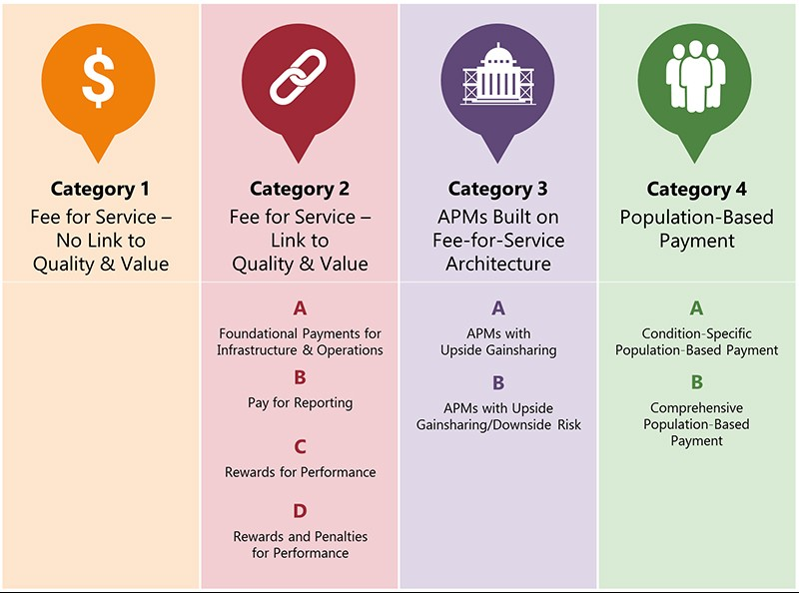
Key MLTSS RFP Questions
Value Based Payment questions are
Based on HCP-LAN framework
1
Current Experience with VBP & APMs
Current Use | Medicaid | Commercial | Medicare
Provider Type
VBP by HCP-LAN category
% of medical expenses for each APM model
Types of Services (primary and acute, BH, LTSS, and others)
Description of numerator/ denominator
2
APM strategies to be most effective for Medicaid ABD population and dually-eligible persons

Slide 31



Key MLTSS RFP Questions (continued)
3
Proposed VBP Plan for Implementation
Development of Provider Readiness for VBP
Relationship to commercial VBP strategy and Medicare in Virginia health care marketplace
Methods and frequency for collecting and providing data from providers
Objectives for APM implementation – scope, provider performance, and timeline for implementation related to each proposed APM model approach

Slide 32
Virginia RFP Learnings
Limited LTSS VBP Experience
LTSS Not Traditionally Part of the Continuum
Barriers to Collaboration
Payment is still mostly tied to utilization
Health plans have limited experience designing APMs for LTSS
Limited provider readiness for APMs (most still in HCP-LAN Category 1)
Public
Agency
Limited infrastructure to facilitate information sharing and collaboration
Lack of provider partnerships limits capacity for care transitions and care coordination
Behavioral
Health
LTSS
Primary
Care
LTSS
Emergency
Department
Social determinants frequently excluded
DMAS also identified the importance of establishing a baseline year

Slide 33
VA Managed LTSS Contract
Annual VBP Plan
VBP Status Report
HCP-LAN Data Submission
  Current State Review
  Provider Readiness
  and Performance
  Review and Communication
  Strategy and Alignment
  VBP Category (HCP-LAN)
  Description, Goals,
  Measurable Results
  Description of Targeted Providers
  Description of Targeted
  Members
  Total Payments to Providers
  Total Potential Payment
  Adjustment
  Potential Overlaps with other VBP programs or initiatives
HCP-LAN Data Submission

Slide 34
DMAS Framework for Next Steps
1
2
3
  Policy
  Decisions
  Roadmap
  Design
  Stakeholder
  Engagement
  Outline policy priorities for VBP
  Determine VBP goals and objectives
  Outline strategy for ongoing stakeholder communications
  Work through policy determinations
  Select key MCO and provider performance indicators
  Use lessons learned to refine VBP Roadmap
  Finalize policy decisions
  Identify potential financial support for provider infrastructure
Process is not entirely linear as some activities occur in parallel

Slide 35
Discussion and Questions
Gretchen Ulbee
Seon
Rockwell
Dan
Meuse
Erin
Taylor
35

Slide 36
Resources
Webinar materials will be emailed to participants and made available on the SHVS website
  http://statenetwork.org/resource/?tag=shran,shvs&topic=&type=
36

